Slide 1
Trajectories of Care at the End of Life in New Zealand
interRAI Services and TAS
Wellington, May 2019

Slide 2
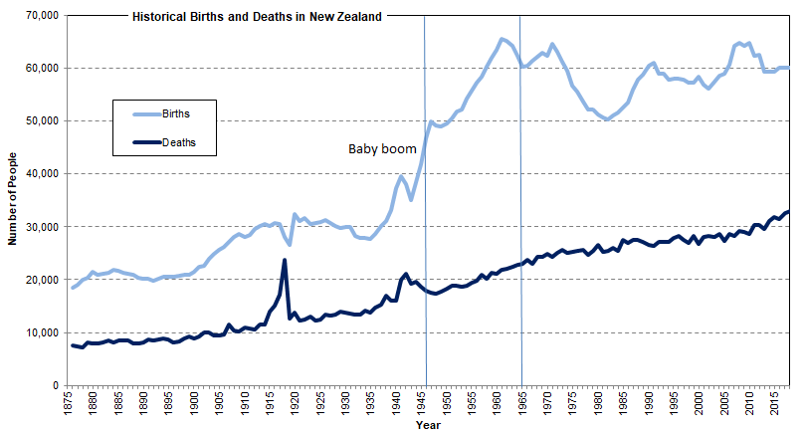
New Zealand Births and Deaths
1876 to 2018
Baby Boomers are usually regarded as those born in the years 1946–65. In New Zealand the increase in births began earlier, in 1935, and the number of births peaked in 1961.
Data Source: Statistics New Zealand, New Zealand Cohort Life Tables 1876-2015 and 2019 update

Slide 3
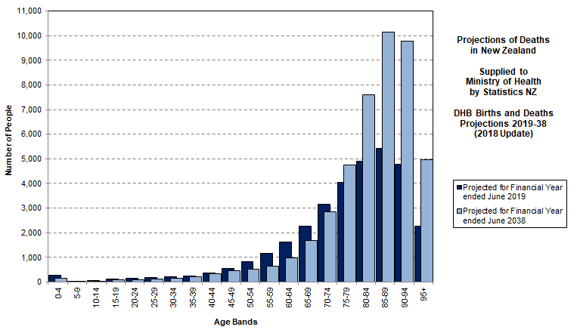
Ageing of Deaths 2019 to 2038
Statistics NZ projects for the Ministry of Health in the “2018 Update” that total deaths will increase from 32,600 a year in FY2019 to 45,500 a year by FY2038, an increase of 40%. There are two important effects: the greater number of deaths and the ageing of those deaths.
Data Source: Statistics NZ, DHB Births and Deaths Projections 2019-38 (2018 Update)

Slide 4
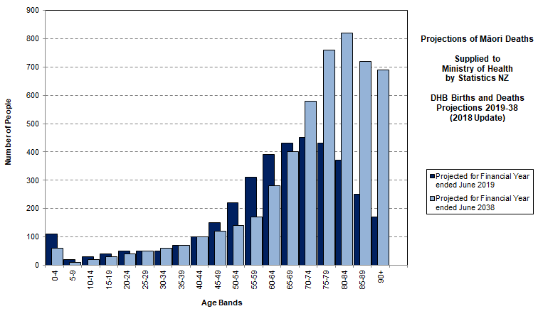
Ageing of Māori Deaths 2018 to 2038
Māori deaths are projected to increase from 3,700 a year in FY2019 to 5,100 a year by FY2038, an increase of 38%. There is projected to be a change in the shape with fewer deaths in the 45-69 range and a substantial increase in deaths from age 70 onwards.
Data Source: Statistics NZ, DHB Births and Deaths Projections 2019-38 (2018 Update)

Slide 5
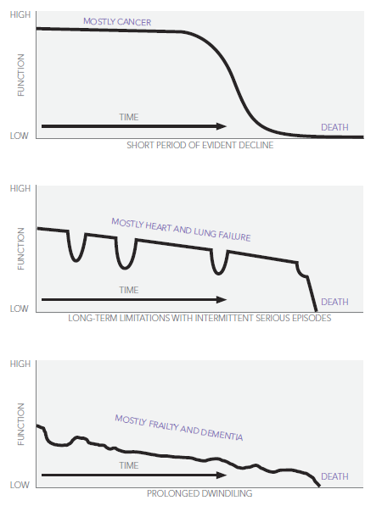
Trajectories at the End of Life
Accidents - early adult years
The three characteristic trajectories illustrated are roughly sequential :
Cancer - peaking around age 65
Organ failure - about a decade later, around age 75
Frailty and dementia - those who live past their mid-80s.
Source: Palliative Care Australia (2010). Health System Reform and Care at the End of Life: a Guidance Document. 2010. Canberra: Palliative Care Australia.
Diagram from Lynn, J., & Adamson, D. M. (2003). Living Well at the End of Life. Adapting Health Care to Serious Chronic Illness in Old Age. 2003. RAND Health.
Notes:
“Trajectory 1 is characterised by a short period of evident decline over a period of weeks or months. Good function may be maintained for some time, with a few weeks or months of rapid decline as the illness becomes overwhelming and leads to death. Generally there is time to anticipate needs and plan for end of life care. While many diseases follow this course, it is typical of the major cancers.
This trajectory meshes well with traditional palliative care services that concentrate on providing comprehensive care over the last weeks or months of a person’s life. About 20 per cent of people will follow this trajectory.”
“Trajectory 2 is characterised by long-term limitation of function with intermittent severe, acute episodes. Patients with heart failure or chronic obstructive pulmonary disease (COPD) are usually ill for many years. They frequently experience acute and often severe exacerbation of their physical symptoms.
These exacerbations are frequently associated with admission to hospital and intensive treatment. If patients survive an episode, they may well return home without much progression of their everyday disabilities. Patients usually survive many such episodes but at some point, rescue attempts fail. The timing of death is often a surprise in this group, despite their long-term chronic illness. Although many illnesses can follow this course, chronic heart failure and emphysema are the most common. About 25 per cent of people will follow this trajectory.”
Trajectory 3: Those who escape cancer and organ failure as they age will be likely to die of either dementia or generalised frailty. This trajectory is characterised by progressive disability from a baseline of already low cognitive or physical function. Gradual decline in functional capacity combined with the impact of often minor physical events—for example a fall or a respiratory or urinary infection—can prove fatal. Approximately 40 per cent of people will follow this trajectory.”
“The three characteristic trajectories described above are roughly sequential in relation to the ages afflicted, with illness trajectory 1 (cancer) peaking around age 65, fatal chronic organ system failure (trajectory 2) about a decade later and frailty and dementia (trajectory 3) afflicting those who live past their mid-eighties.”
[Palliative Care Australia (2010). Health System Reform and Care at the End of Life: a Guidance Document. 2010. Canberra: Palliative Care Australia.]
Diagram from Lynn, J., & Adamson, D. M. (2003). Living Well at the End of Life. Adapting Health Care to Serious Chronic Illness in Old Age. 2003. RAND Health. ]

Slide 6
Independent Life Expectancy, MoH Study 1996–2013
Female New Zealander at 65 years of age in 2013 can expect to live:
  another 10.6 years independently, on average, which is 49.5% of her remaining life
  a further 10.7 years with functional limitations requiring assistance
    non-daily assistance for 5.9 years
    daily assistance for final 4.8 years.
Male New Zealander at 65 years of age in 2013 can expect to live :
  another 10.2 years independently, on average, which is 54.1% of his remaining life
  a further 8.7 years with functional limitations requiring assistance
    non-daily assistance for 5.6 years
    daily assistance for the final 3.1 years.
Source: Ministry of Health (2015) Independent Life Expectancy in New Zealand, 2013.

Slide 7
Trajectories Study and Period
All deaths occurring and registered in 2015
History of health care utilisation going back ten years where feasible.
  Cancer Registry and NMDS are longer (around 25 years).
  interRAI is shorter (mostly 3 years, with earlier pilots)
Study question: who is not reached by specialist palliative care (hospices and hospitals) or by aged residential care (ARC).
The intention is to provide an understanding of the different trajectories of care at the end of life.
Advise on feasibility of a minimum data set for hospital palliative care.
Identify funding flows for end of life care.
Notes:
The aim of the project is to use national data linked by NHI number to provide an answer to the question: who is not reached by specialist palliative care (hospices and hospitals) or by aged residential care (ARC). That would identify the size of the primary care work-load, by DHB and region.
One year of deaths to be studied, with a history of health care utilisation going back ten years where feasible.
The overlaps and gaps in service by cause of death, place of death, age, gender, ethnicity and deprivation to be investigated. Results nationally, regionally and by DHB to inform service development.
The intention is to provide an understanding of the different trajectories of care at the end of life, contrasting sudden deaths, cancer patients, chronic disease, and those with frailty and dementia.
The Ministry of Health commissioned the project, which began in September 2017.

Slide 8
Trajectories Study Data
Linked data sets, using de-identified NHI number:
  Mortality Collection (MORT)
  New Zealand Cancer Registry (NZCR)
  National Minimum Dataset (Hospital Events) (NMDS) - inpatients
  National Non-Admitted Patients Collection (NNPAC) - outpatients
  PRIMHD mental health data (PRIMHD)
  Laboratory Claims Collection (Labs)
  Pharmaceutical Collection (Pharms)
  PHO Enrolment Collection (PHO)
  General Medical Subsidy Collection (GMS) – other GP used
  Disability Support Services (SOCRATES)
  Aged Residential Care Subsidies (CCPS)
  interRAI Assessments (interRAI)
  History of Hospice Care and Hospice IPU for 30 hospices

Slide 9
New Insights from Linked Data

Slide 10
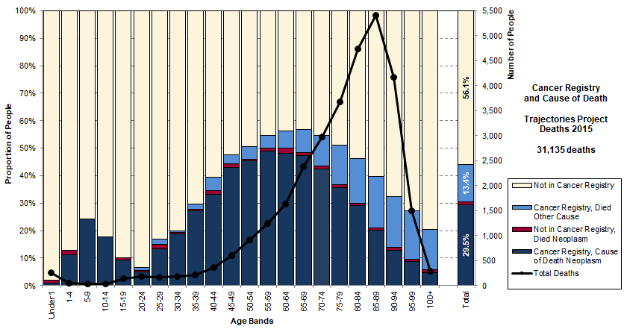
Cancer Registry and Cause of Death
In total, 43.0% of all deaths are in the Cancer Registry. 29.5% are in the Cancer Registry and have neoplasm as cause of death. A further 1.0% have neoplasm as cause of death, but are not in the Cancer Registry (neoplasm includes some benign tumours). Of interest are the 13.4% who are in the Cancer Registry but died of another cause – they tend to be older.
Data Source: Trajectories Project, linked data for deaths in New Zealand in 2015

Slide 11
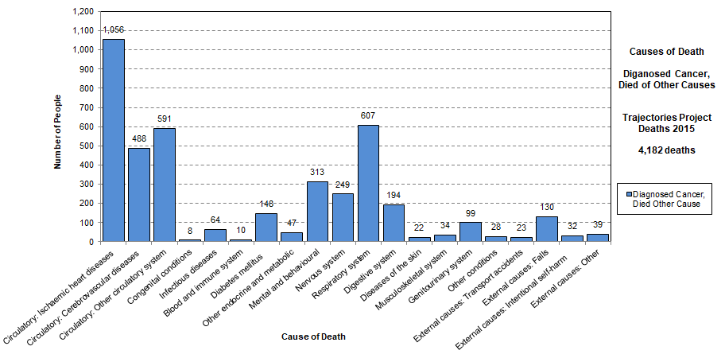
Died with Cancer, not from Cancer
Overall, 4,182 people (13.4% of all deaths) are in the Cancer Registry but died of other causes. Circulatory system conditions accounted for 51.1%, External causes for 5.4% and Other conditions for 43.4%. Of the Other conditions, Respiratory system causes were the largest group.
Data Source: Trajectories Project, linked data for deaths in New Zealand in 2015

Slide 12
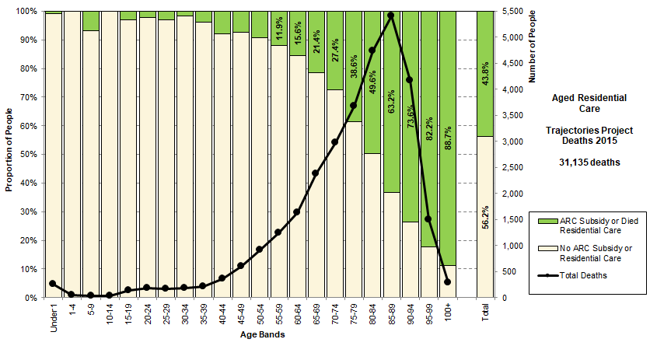
Aged Residential Care
In total, 43.8% of all deaths have an aged residential care subsidy or were recorded as having died in residential care. There is a very strong pattern that increases sharply with age: 73.6% by age 90-94, 82.2% by age 95-99 and 88.7% for those aged 100 or more.
Data Source: Trajectories Project, linked data for deaths in New Zealand in 2015

Slide 13
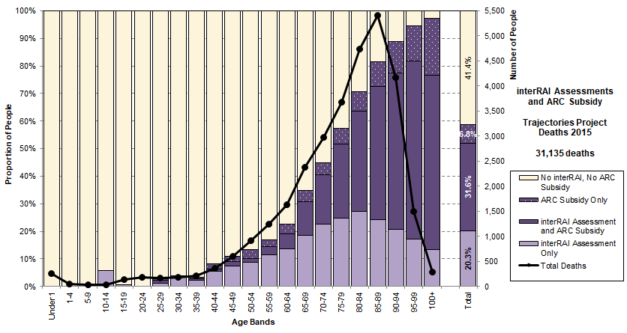
interRAI Assessment, Potential
In total, 51.8% of total deaths had one or more interRAI assessments. A further 6.8% had an ARC subsidy at some time. With interRAI assessments becoming mandatory in aged residential care from 1 July 2015, the potential total is 58.6% of all deaths, with a very strong pattern by age.
Data Source: Trajectories Project, linked data for deaths in New Zealand in 2015

Slide 14
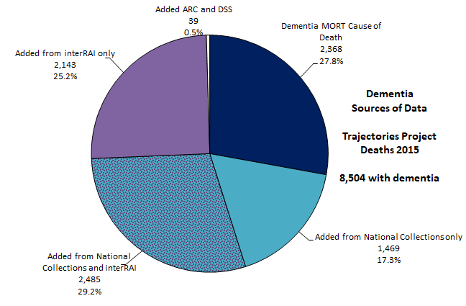
Dementia Sources of Data
Importance
27.8% of all dementia identified from mortality data. This shows the impact of the main sources of data and the extent of overlaps. National Collections (NMDS and PHARMS) and interRAI (diagnosis and Cognitive Performance Scale) are the most important sources. There is significant overlap.
Data Source: Trajectories Project, linked data for deaths in New Zealand in 2015

Slide 15
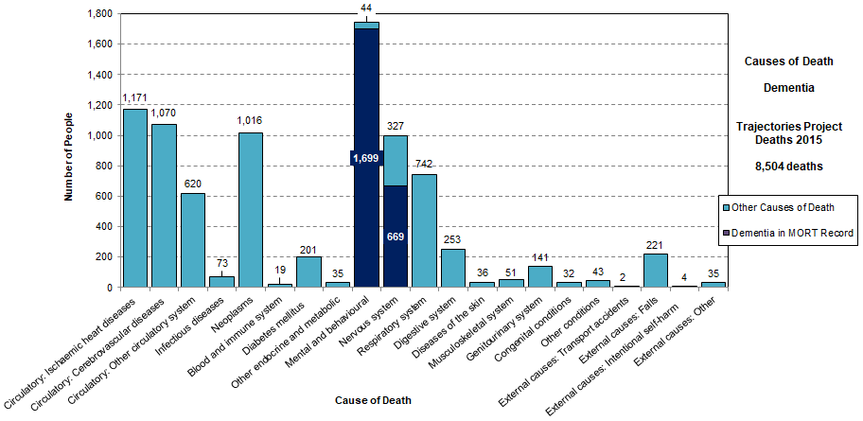
Cause of Death - Died with Dementia
Of those identified with dementia, only 27.8% had dementia as a cause of death on the death certificate. 72.2% of people with dementia died of other causes. Circulatory system causes are the largest group, followed by deaths from cancer and respiratory system causes.
Data Source: Trajectories Project, linked data for deaths in New Zealand in 2015

Slide 16
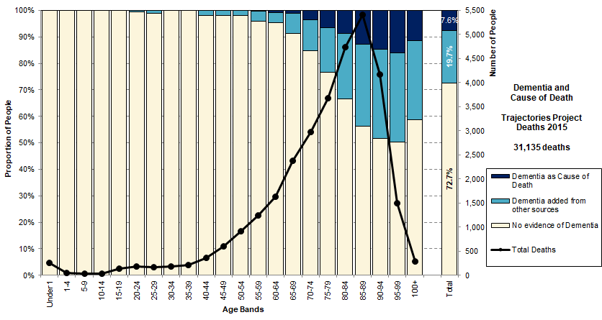
Dementia and Cause of Death
Dementia is known to be poorly represented as a cause of death. Only 7.6% of all deaths identified as having a form of dementia from mortality data. By combining any evidence of dementia from other sources, we find that a further 19.7% have dementia, making 27.3% of total deaths.
Data Source: Trajectories Project, linked data for deaths in New Zealand in 2015

Slide 17
Trajectory Groups
Development of Groups

Slide 18
Trajectories Groups
The trajectories groups are extracted sequentially as follows:
Dementia: anyone with any evidence of dementia (MORT, hospital, medicines, interRAI diagnosis or Cognitive Performance Scale).
Cancer: no evidence of dementia, any cancer and died of neoplasm, or died of neoplasm (Cancer Registry, MORT).
Chronic Disease: no evidence of dementia, cause of death not neoplasm, any aged residential care subsidy or place of death residential care, or any interRAI. These are effectively the frail older people who need some assistance (ARC or assessed for home care).
Need and Maximal Need: all other causes of death that are included in the need for palliative care or the maximal need for palliative care. They may have chronic disease but are generally younger. Includes a young group receiving Disability Support Services if not already allocated.
Other Sudden Deaths: cause of death is not in maximal need for palliative care and not already allocated above.
Data Source: Trajectories Project, linked data for deaths in New Zealand in 2015

Slide 19
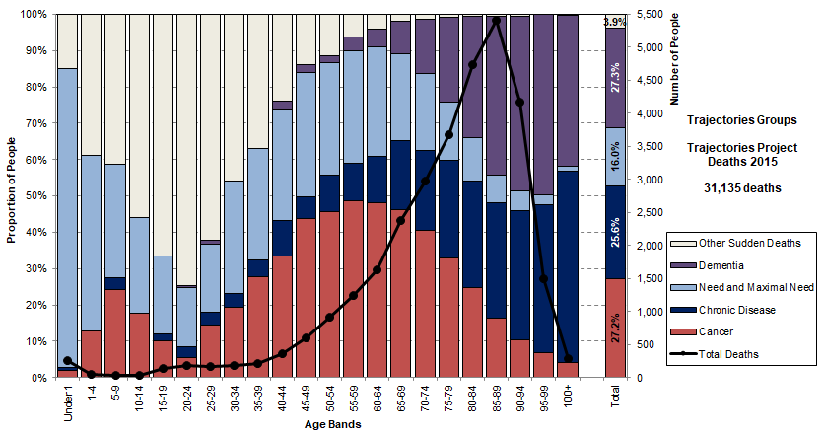
Trajectories Groups
Trajectories Groups allocated sequentially: Dementia, Cancer (diagnosed cancer, died of neoplasm), Chronic Disease (needing ARC or interRAI assessment for home care), Need and Maximal Need (including Disability Support Services), Other Sudden Deaths.
Data Source: Trajectories Project, linked data for deaths in New Zealand in 2015

Slide 20
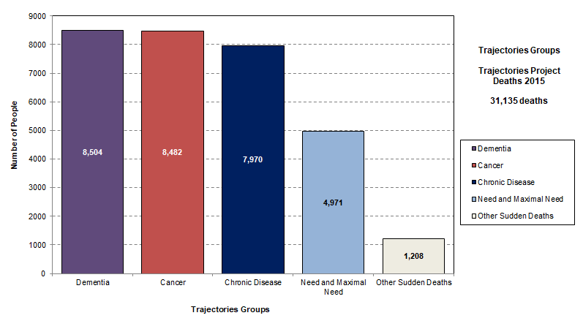
Trajectories Groups
The groups are allocated from left to right. The Dementia and Cancer groups are large in their own right. The amalgamated Chronic Disease group is almost the same size. The analysis that follows will typically use these five major groups.
Data Source: Trajectories Project, linked data for deaths in New Zealand in 2015

Slide 21
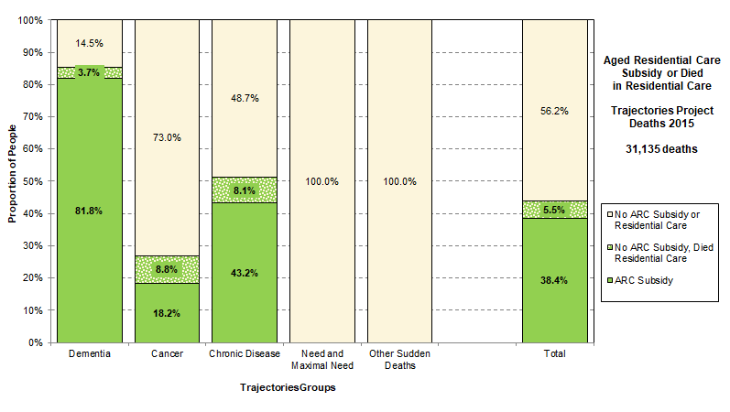
ARC Subsidy or Residential Care
Overall 43.8% of people used residential care at some time in their trajectory. This is highest for the Dementia group at 85.5%. More than half of Chronic Disease (51.3%) and more than a quarter of the Cancer group (27.0%) had an ARC subsidy or died in residential care.
Data Source: Trajectories Project, linked data for deaths in New Zealand in 2015

Slide 22
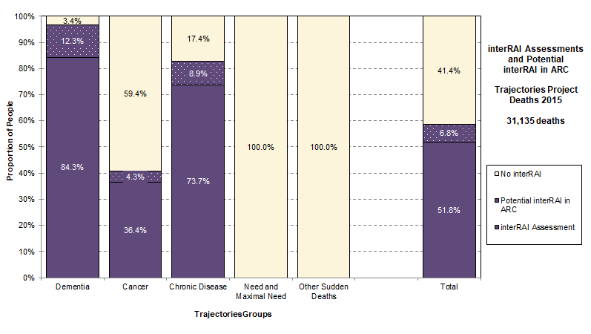
interRAI Assessment, Potential
The potential total of assessments (including all in ARC) is 58.6% of all deaths. Almost the whole Dementia group has an assessment (96.6%), and this does not yet include those not giving consent to share data. 82.6% for the Chronic Disease group and only 40.6% for the Cancer group.
Data Source: Trajectories Project, linked data for deaths in New Zealand in 2015

Slide 23
Utilisation of Services
Time before Death

Slide 24
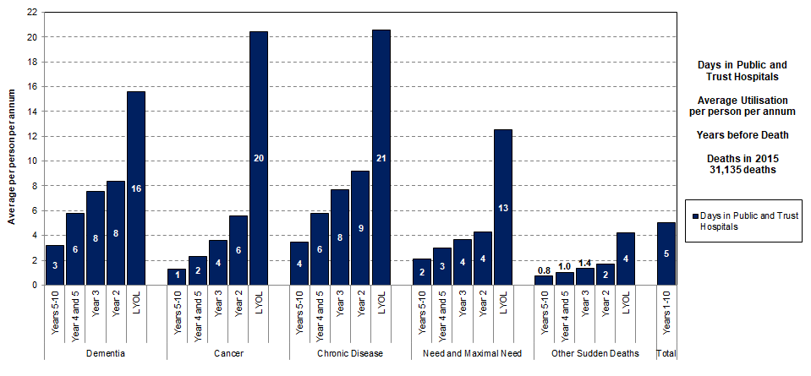
Days in Public Hospital pppa
All groups have increasing utilisation throughout the ten years and much higher utilisation in the last year of life. Cancer and Chronic Disease have almost the same in LYOL, but Cancer is lower in earlier years. The lowest users of public hospital days are the Other Sudden Death group.
Data Source: Trajectories Project, linked data for deaths in New Zealand in 2015

Slide 25
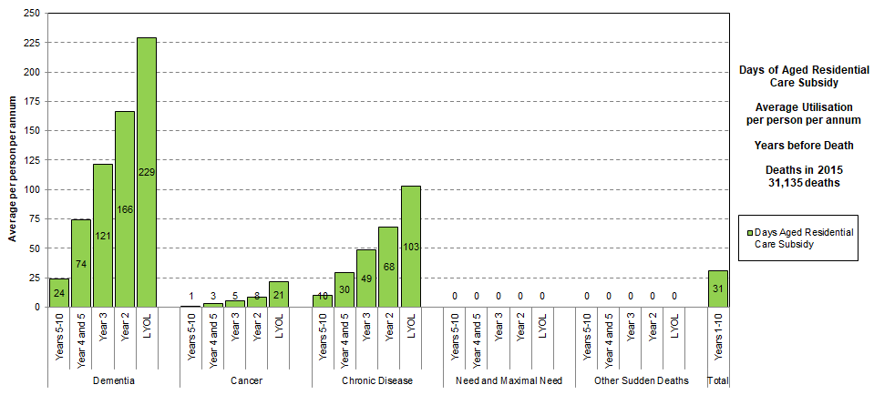
Days of ARC Subsidy pppa
The Dementia group have a high and increasing utilisation throughout the ten years. Chronic Disease also have a sustained increase over time but to less than half of the level. Cancer has some usage, particularly in the last year of life. Two groups have no days of ARC subsidy in the last ten years.
Data Source: Trajectories Project, linked data for deaths in New Zealand in 2015

Slide 26
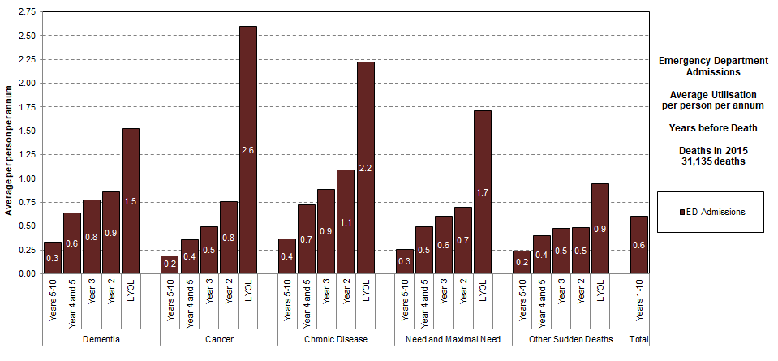
Emergency Dept. Admissions pppa
All groups have higher ED utilisation in LYOL. The Cancer group has the largest increase in the LYOL, followed by Chronic Disease and then Need and Maximal Need. Would be useful to study impact of early referral to hospice on the Cancer group usage of ED.
Data Source: Trajectories Project, linked data for deaths in New Zealand in 2015

Slide 27
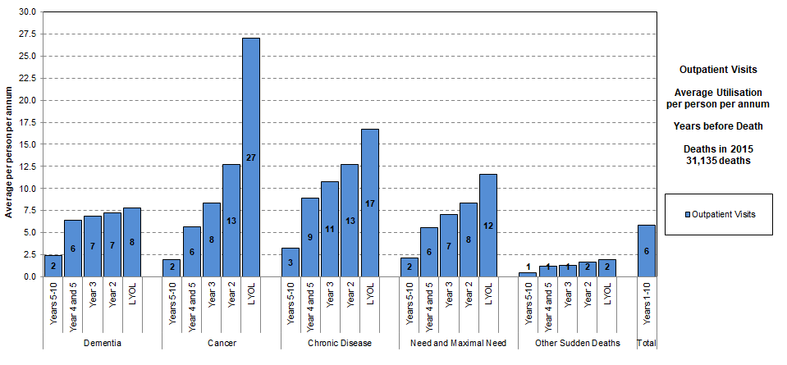
Outpatient Visits pppa
The Cancer group have the highest utilisation and highest increase in outpatient visits in the last year of life. Chronic Disease have higher usage initially, but not as high as Cancer in the LYOL. Dementia group have lower OP visits in last years – perhaps impacted by being in ARC.
Data Source: Trajectories Project, linked data for deaths in New Zealand in 2015

Slide 28
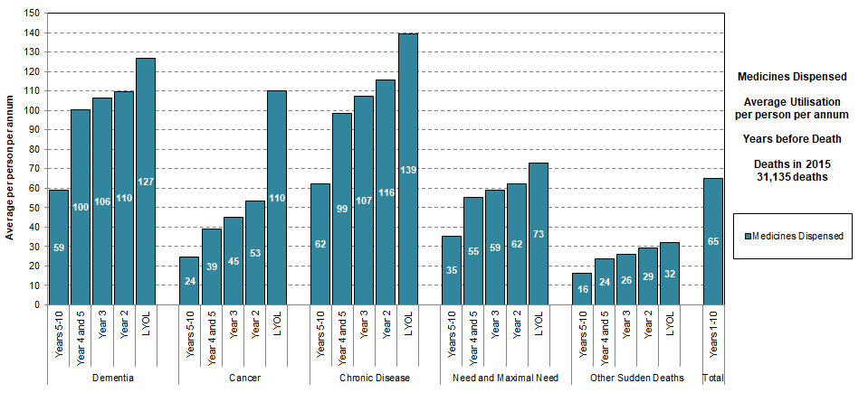
Medicines Dispensed pppa
Chronic Disease have the highest average number of medicines dispensed pppa, followed by Dementia. Cancer group have a large increase in the LYOL from a lower base usage. Need and Maximal Need have relatively constant utilisation, at about half the levels of those in Chronic Disease.
Data Source: Trajectories Project, linked data for deaths in New Zealand in 2015

Slide 29
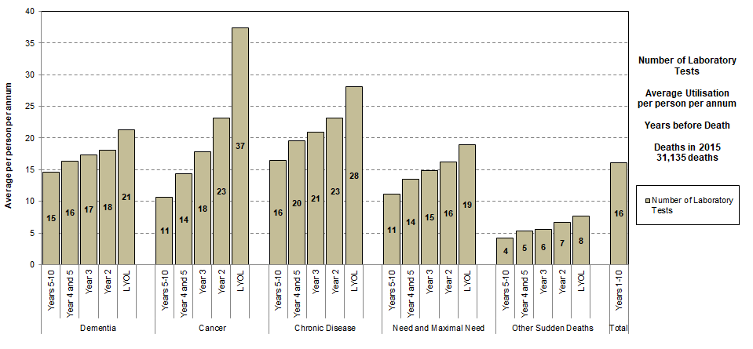
Laboratory Tests pppa
Chronic Disease have the highest sustained utilisation of laboratory tests pppa, but Cancer group increases rapidly and in the highest in the LYOL. Dementia group is similar in shape to Need and Maximal Need, but slightly higher each period.
Data Source: Trajectories Project, linked data for deaths in New Zealand in 2015

Slide 30
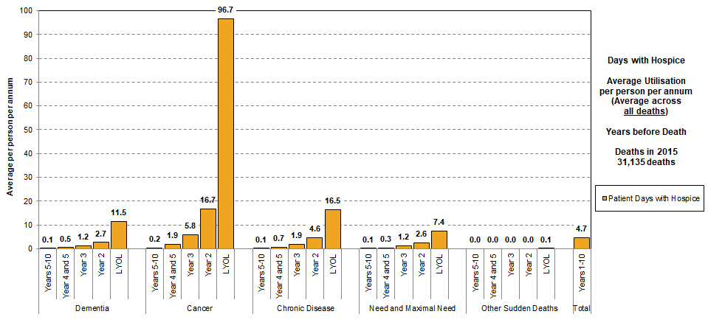
Days with Hospice pppa
This shows the average utilisation of hospice across all deaths in each trajectory group. For every person in the Cancer group, on average there were 96.7 days with hospice in the last year of life and 16.7 days in the previous year. Be wary of averages as some people have much shorter trajectories while some are with hospice the whole of that year.
Data Source: Trajectories Project, linked data for deaths in New Zealand in 2015

Slide 31
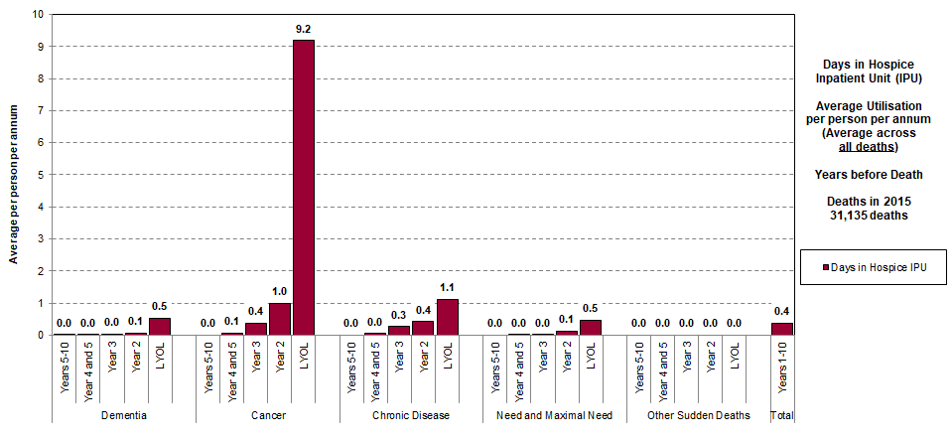
Days in Hospice IPU pppa
This shows the average utilisation of hospice IPU across all deaths in each trajectory group. For every person in the Cancer group, on average there were 9.2 days in IPU in the last year of life and 1.0 days in the previous year.
Data Source: Trajectories Project, linked data for deaths in New Zealand in 2015

Slide 32
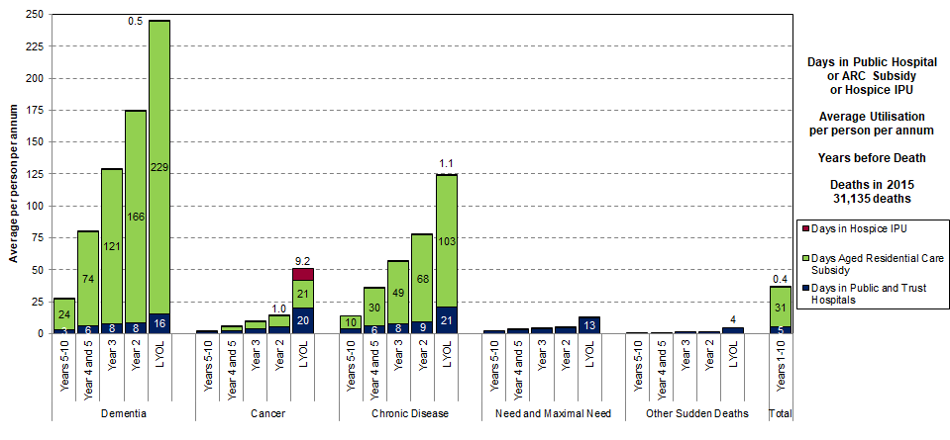
Days Hospital, ARC, Hospice IPU pppa
The Cancer group has an added 9.2 days from hospice IPU in the LYOL with 1.0 days in Year 2. The Chronic disease group has an added 1.1 days in the LYOL. For all other groups and time periods, the addition of hospice IPU adds small amounts less than one day.
Data Source: Trajectories Project, linked data for deaths in New Zealand in 2015

Slide 33
Time before Death
First Admission to ARC
First Referral to Hospice

Slide 34
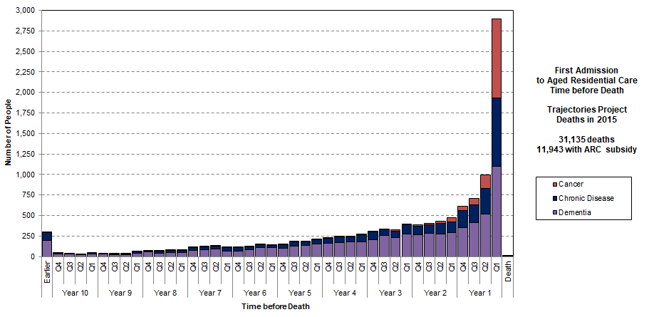
Timing of First Admission to ARC
There are people with very short stays in aged residential care: overall, 43.7% have their first admission less than one year before death and 24.3% have their first admission in the last three months of life.
Data Source: Trajectories Project, linked data for deaths in New Zealand in 2015

Slide 35
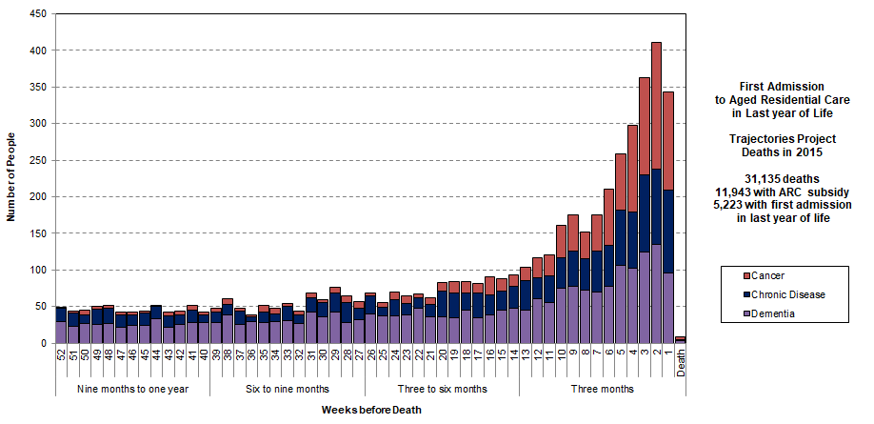
First Admission to ARC in LYOL
Eight people were admitted for the first time on the day of death and 343 in the last week of life. In the last four weeks of life, 1,423 were admitted (11.9% of those with any ARC subsidy). In the last three months of life, 2,897 were admitted for the first time (24.3% of those with an ARC subsidy).
Data Source: Trajectories Project, linked data for deaths in New Zealand in 2015

Slide 36
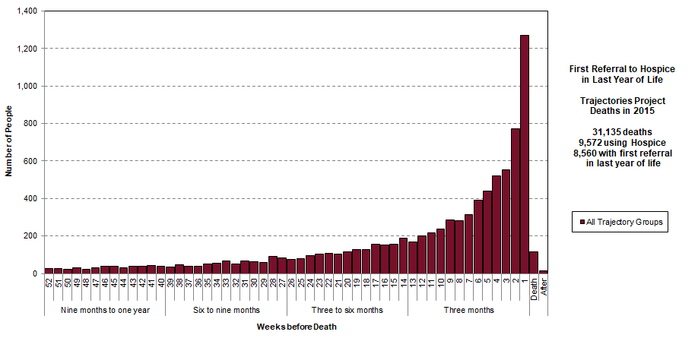
First Referral to Hospice in LYOL
Referrals to hospice are happening late in the trajectory: there were referrals in the last three months of life for 60.3% of hospice users, in the last four weeks of life for 33.8% and in the last week of life for 13.3% of hospice users. 117 people were referred to hospice only on the day of death and for 16 people the referral arrived after death.
Data Source: Trajectories Project, linked data for deaths in New Zealand in 2015

Slide 37
Utilisation in LYOL
Public Hospital and ED Events
Use of an Institutional Bed

Slide 38
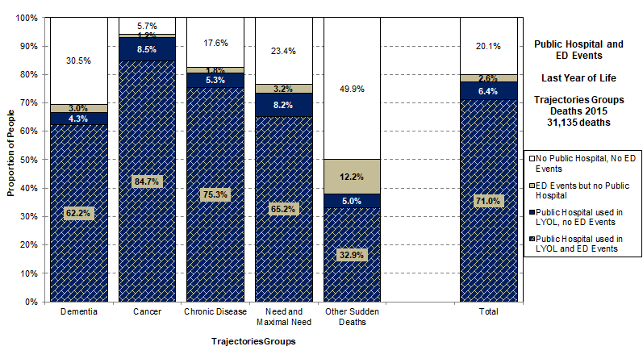
Public Hospital and ED in LYOL
71.0% of all deaths have both public hospital admissions and ED events in the LYOL. The Cancer group has the highest level at 84.7%. A significant proportion of those in the Dementia group have no use of public hospital or any ED event (30.5%).
Data Source: Trajectories Project, linked data for deaths in New Zealand in 2015

Slide 39
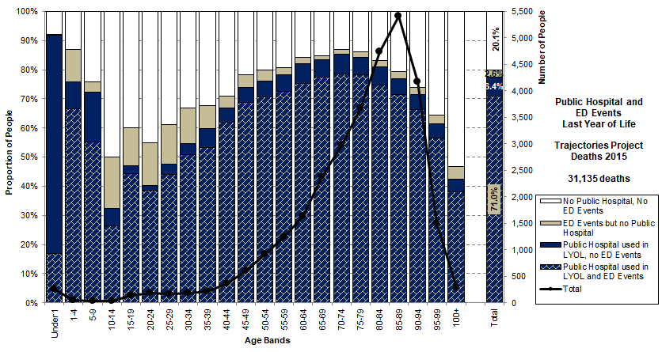
Public Hospital and ED in LYOL
71.0% of all deaths have both public hospital and ED events in the LYOL. The highest proportional use of ED only and of neither is in the accident years. A strong decline in ED events and public hospital use at older ages.
Data Source: Trajectories Project, linked data for deaths in New Zealand in 2015

Slide 40
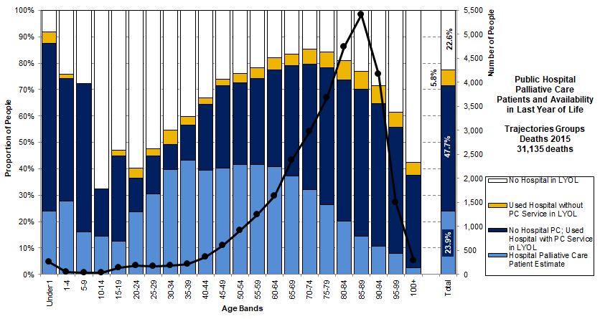
Hospital Palliative Care Availability
Comparing those receiving hospital palliative care with those who had a hospital admission in the LYOL to a hospital with or without a palliative care (PC) service. Overall, 48% had an admission to a public hospital with a PC service but did not receive palliative care. There seems to be a widening gap in access to hospital palliative care from around age 50 onwards.
Data Source: Trajectories Project, linked data for deaths in New Zealand in 2015

Slide 41
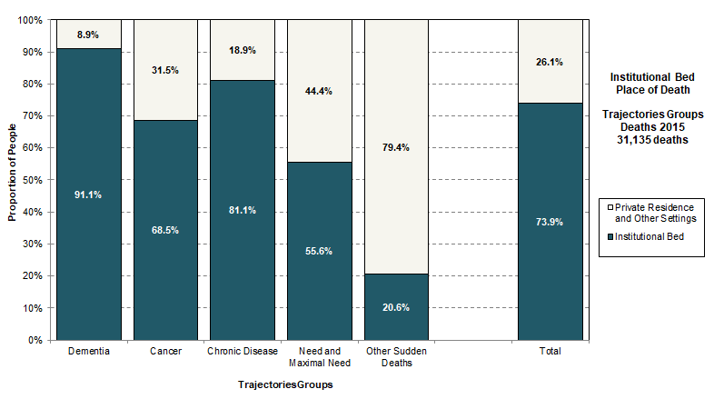
Institutional Bed for Place of Death
Overall, 73.9% of the deaths in 2015 had some sort of institutional bed as the place of death (public hospital, aged residential care or hospice IPU). This is 91.1% for Dementia, 81.1% for Chronic Disease and 68.5% for the Cancer group.
Data Source: Trajectories Project, linked data for deaths in New Zealand in 2015

Slide 42
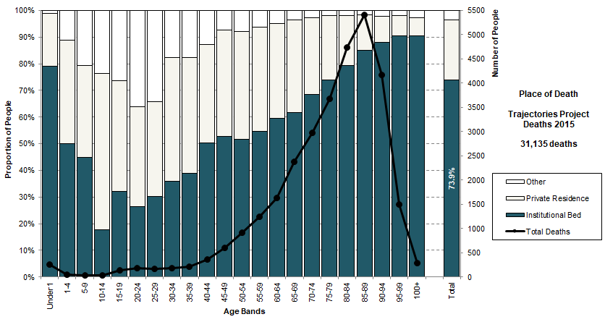
Institutional Bed for Place of Death
Looking at the place of death data with a different lens by combining the three key places providing a bed at the end of life. The use of some form of institutional bed (public hospital or residential care or hospice IPU) is almost linear with age from age 10 onwards, reaching over 90% by age 95.
Data Source: Trajectories Project, linked data for deaths in New Zealand in 2015

Slide 43
Need for Palliative Care
Hospices, Aged Residential Care and Primary Care

Slide 44
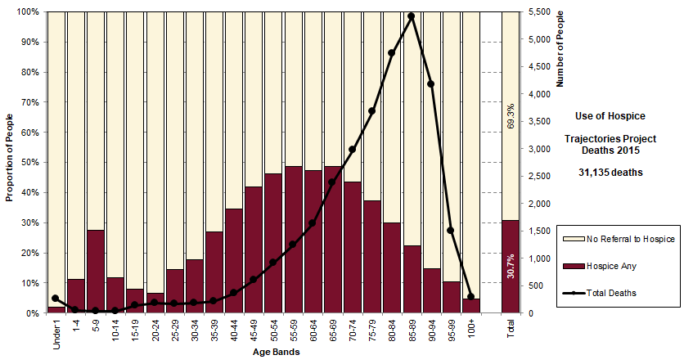
Use of Hospice Services
Overall, 30.7% of people in the Trajectories study used hospice as part of their end of life trajectory. There is a strong and characteristic pattern by age, with almost 50% of those dying in the age bands from 55 to 70 using hospice.
Data Source: Trajectories Project, linked data for deaths in New Zealand in 2015

Slide 45
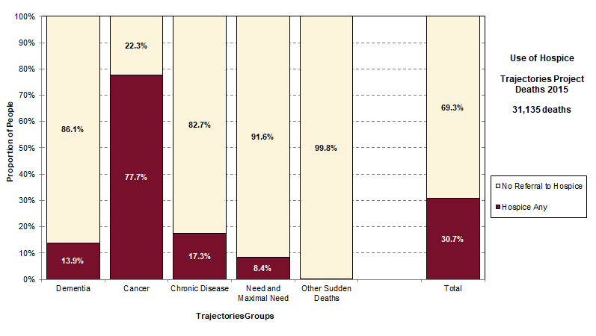
Use of Hospice Services
Overall, 30.7% of people in the Trajectories study used hospice as part of their end of life trajectory. This was highest for the Cancer group at 77.7%. 13.9% of those with Dementia and 17.3% of the Chronic Disease group used hospice.
Data Source: Trajectories Project, linked data for deaths in New Zealand in 2015

Slide 46
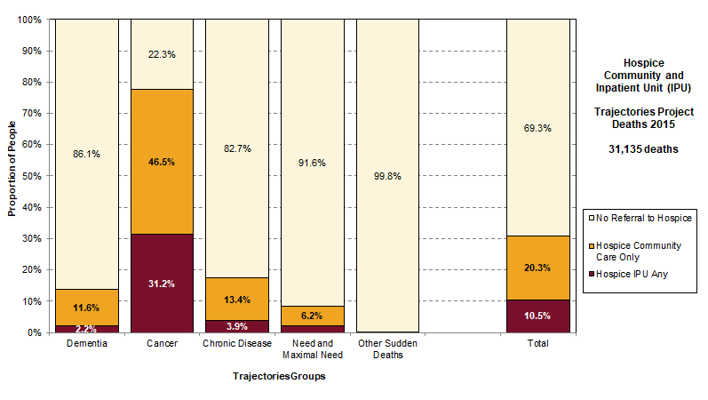
Use of Hospice and Hospice IPU
Hospice is a philosophy and not a place of care. While 30.7% of people in the Trajectories study used hospice as part of their end of life trajectory, only 10.5% used a hospice inpatient unit (IPU). Use of hospice IPU was highest for the Cancer group at 31.2%.
Data Source: Trajectories Project, linked data for deaths in New Zealand in 2015

Slide 47
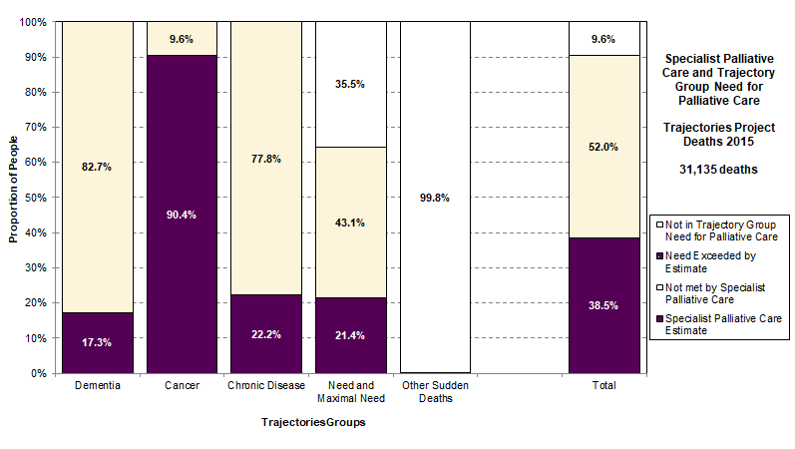
Specialist Palliative Care and Need
It is estimated that specialist palliative care was provided to 38.5% of total deaths. If the assumptions about overlap and spread between groups are valid, then 90% of the Cancer group received specialist palliative care, while only around 18-22% of the Dementia, Chronic Disease, and “Need and Maximal Need” groups did so. This seems plausible.
Data Source: Trajectories Project, linked data for deaths in New Zealand in 2015
Notes:
Specialist palliative care is estimated to have been provided to 47.3% of original definition of Need for Palliative Care and 42.5% of the Trajectory Group Need for Palliative Care.

Slide 48
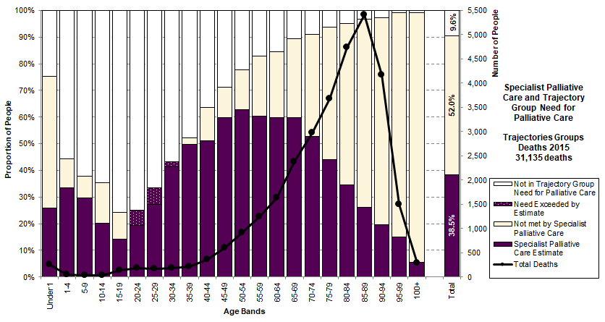
Specialist Palliative Care and Need
May understate specialist paediatric palliative care
May understate Specialist Paediatric Palliative Care
It is estimated that specialist palliative care was provided to 38.5% of total deaths. 52.0% of total deaths fall within the definition of need, but were not seen by specialist palliative care (hospices or hospital palliative care).
Specialist palliative care met 42.5% of the Trajectory Group Need for Palliative Care.
Data Source: Trajectories Project, linked data for deaths in New Zealand in 2015
Notes:
Specialist palliative care is estimated to have been provided to 47.3% of original definition of Need for Palliative Care and 42.5% of the Trajectory Group Need for Palliative Care.

Slide 49
Summary of Findings on Specialist Palliative Care
The proportion using hospice is known directly from the data but the proportion using hospital palliative care, and the overlap to hospice usage, is an informed estimate.
We will only know this with certainty if Hospital Palliative Care NZ can aggregate data and provide NHI numbers to allow direct linking.
Overall, 14.6% of total deaths only used hospice, 7.7% only used hospital palliative care and 16.2% used both.
In total, specialist palliative care was 38.5% of total deaths.
The Trajectory Group Need for Palliative Care is 90.4% of total deaths.
It is estimated that Specialist palliative care met 42.5% of the need for palliative care.
Data Source: Trajectories Project, linked data for deaths in New Zealand in 2015
Notes:
Percent Need for Palliative Care 47.3%
Percent Trajectory Group Need for Palliative Care 42.5%
Percent Total Deaths 38.5%

Slide 50
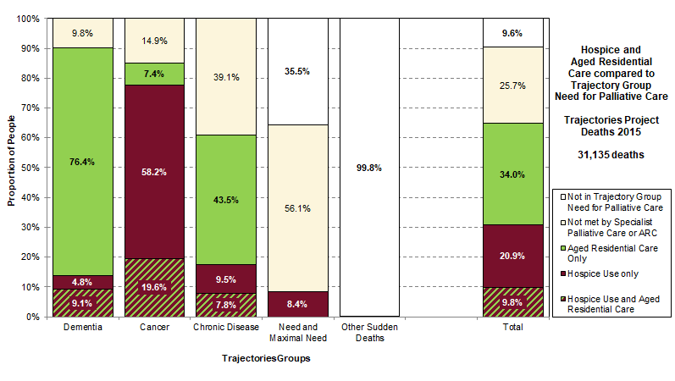
Hospice, Aged Residential Care, Need
Overall, 64.8% used hospice services or aged residential care (ARC). 9.6% of total deaths fall outside the Trajectory Group Need for Palliative Care, leaving a cream group of 25.7% needing on-going palliative care from the primary care team. Some may have seen a hospital palliative care team, but this would have been a short intervention.
Data Source: Trajectories Project, linked data for deaths in New Zealand in 2015

Slide 51
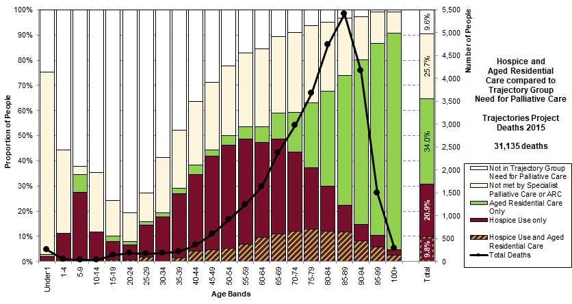
Hospice, Aged Residential Care, Need
Overall, 64.8% used hospice services or aged residential care (ARC). 9.6% of total deaths fall outside the Trajectory Group Need for Palliative Care, leaving a cream group of 25.7% needing on-going palliative care from the primary care team. Some may have seen a hospital palliative care team, but this would have been a short intervention.
Data Source: Trajectories Project, linked data for deaths in New Zealand in 2015

Slide 52
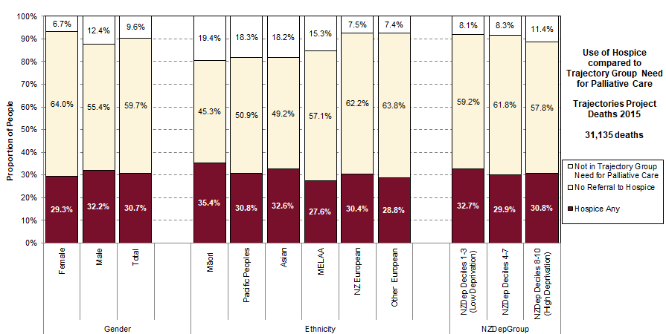
Hospice and Need for Palliative Care
Overall, 30.7% of people used hospice as part of their end of life trajectory. The proportion was higher for men (32.2%) than women. By ethnicity, usage was highest for Māori (35.4%) and Asian (32.6%). The low deprivation group (NZDep 1-3) had higher proportional usage than the other groups. The cream gap is highest for women, European and middle levels of deprivation.
Data Source: Trajectories Project, linked data for deaths in New Zealand in 2015

Slide 53
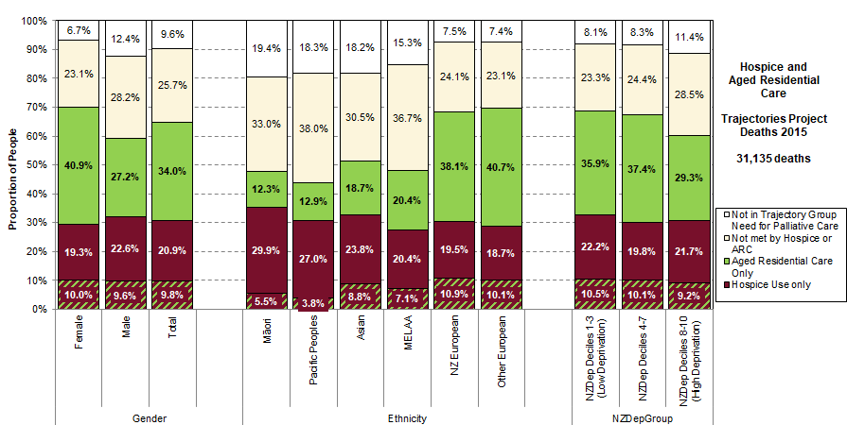
Hospice or ARC and Need for PC
For deaths at older ages, aged residential care is the setting where palliative care needs to be delivered. The cream group is seen by neither hospice nor aged residential care, and thus relies on primary care and district nursing for palliative care at the end of life.
Data Source: Trajectories Project, linked data for deaths in New Zealand in 2015

Slide 54
Trajectory Groups
National Projections to 2038

Slide 55
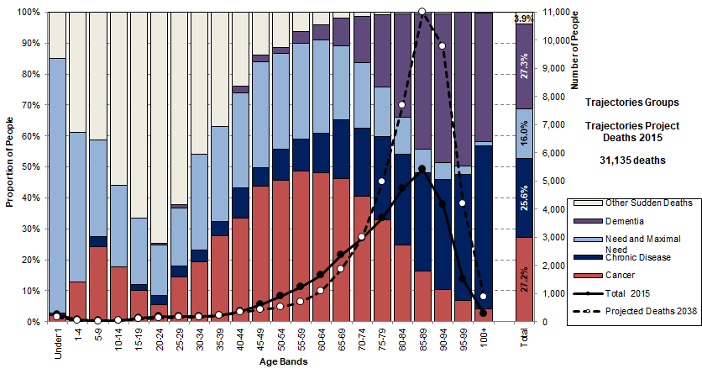
Trajectories Groups - Deaths in 2038
Statistics NZ projects that total deaths will reach 47,400 a year by 2038, which is 52.2% higher than in the Trajectories Study. We expect a greater number of deaths and an ageing of those deaths by 2038.
Data Source: Trajectories Project, linked data for deaths in New Zealand in 2015
Projections by Statistics NZ for Ministry of Health, 2017 Update.

Slide 56
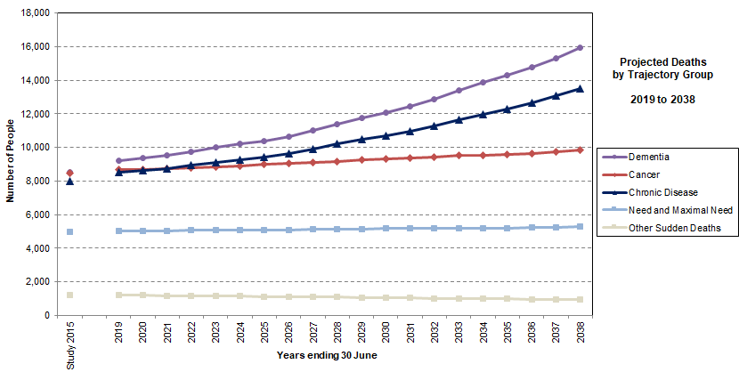
Projected Deaths by Trajectory Group
The patterns by age for the five trajectory groups are from the Trajectories Study 2015. The projected ageing of deaths results in the Dementia and Chronic Disease groups growing much faster than other groups.
Data Source: Projections of Trajectories at the End of Life Model Version vF1 Trajectory Groups

Slide 57
Time in Community
Last Three Years of Life

Slide 58
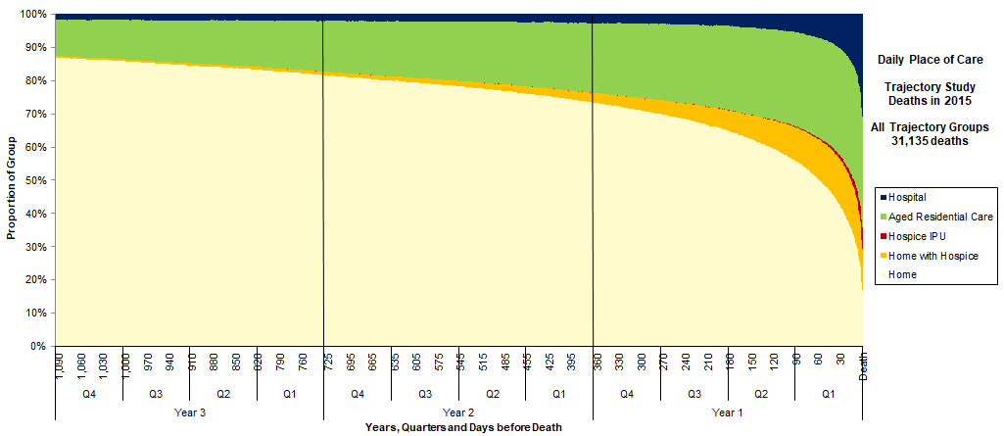
All Trajectory Groups
Daily place of care for each day in the last three years of life, showing all trajectory groups combined. The next slides show the five trajectory groups in the reverse order in which they are extracted.
Data Source: Trajectories Project, linked data for deaths in New Zealand in 2015

Slide 59
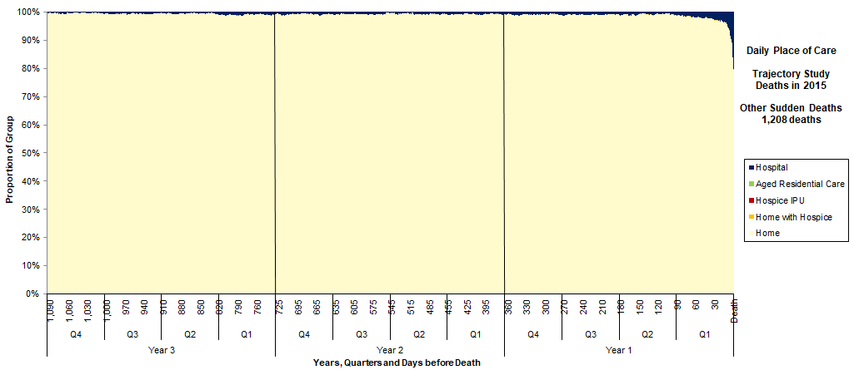
Other Sudden Deaths Group
Daily place of care for each day in the last three years of life, showing the group Other Sudden Deaths. These are deaths not in the definition of Need for Palliative Care and are typically accidents, violence or self-harm.
Data Source: Trajectories Project, linked data for deaths in New Zealand in 2015

Slide 60
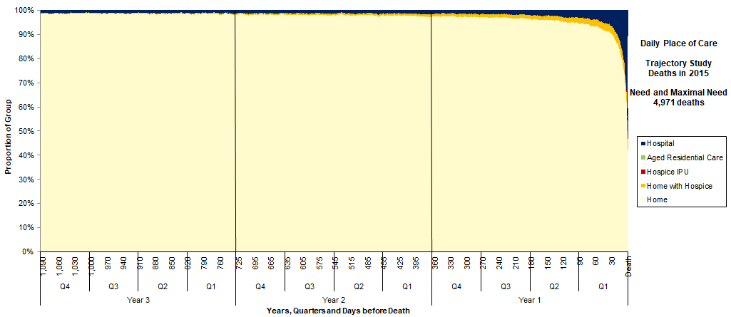
Need and Maximal Need Group
Daily place of care for each day in the last three years of life, showing the group Need and Maximal Need. These are generally younger people, including those who died of congenital conditions.
Data Source: Trajectories Project, linked data for deaths in New Zealand in 2015

Slide 61
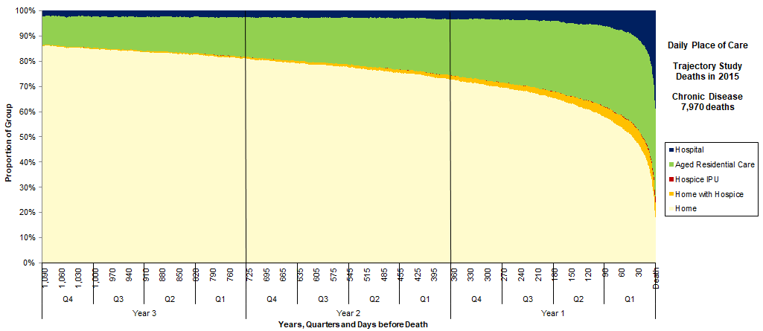
Chronic Disease Group
Daily place of care for each day in the last three years of life, showing the Chronic Disease group. This group is effectively the frail elderly with chronic disease: they either use ARC or have had an interRAI assessment. They have no evidence of dementia and did not die of a neoplasm.
Data Source: Trajectories Project, linked data for deaths in New Zealand in 2015

Slide 62
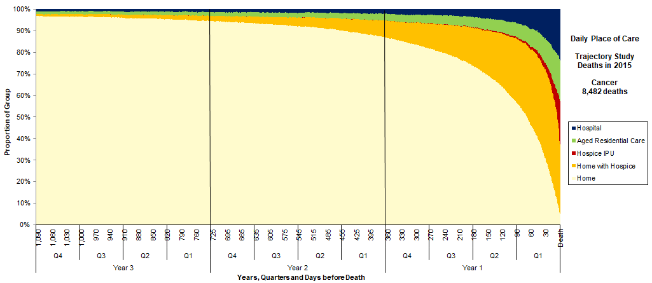
Cancer Group
Daily place of care for each day in the last three years of life, showing the Cancer group. This group has no evidence of dementia, are in the Cancer Registry and died of neoplasms. It also includes some who are not in the Cancer Registry but have a neoplasm as the underlying cause of death.
Data Source: Trajectories Project, linked data for deaths in New Zealand in 2015

Slide 63
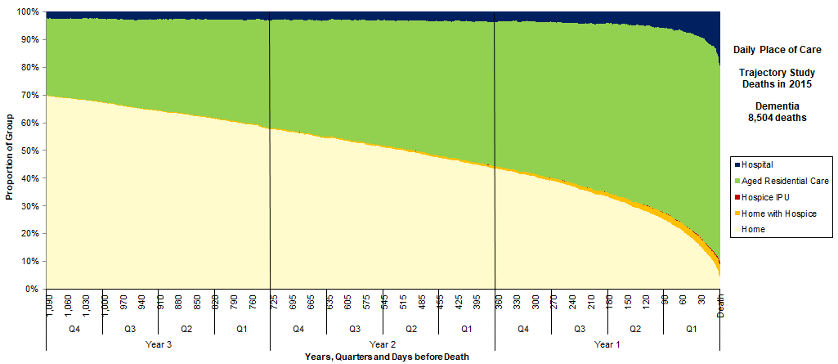
Dementia Group
Daily place of care for each day in the last three years of life, showing the Dementia group. This group died of dementia or has evidence of dementia from the National Collections, or interRAI, or is in a secure dementia facility.
Data Source: Trajectories Project, linked data for deaths in New Zealand in 2015

Slide 64
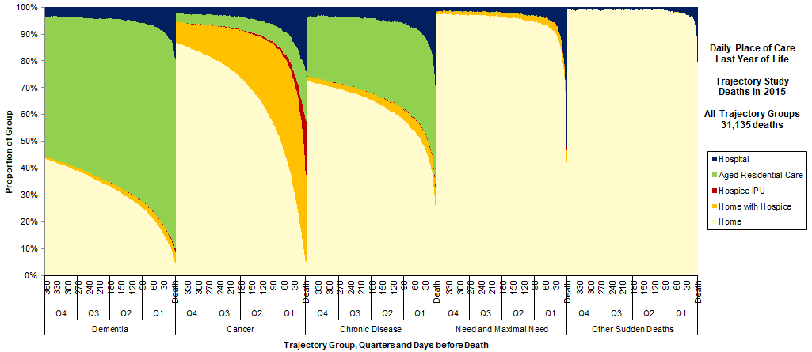
Last Year of Life by Trajectory Group
Daily place of care for each day in the last year of life (LYOL), showing each trajectory group. Shown as a percentage of each group.
Data Source: Trajectories Project, linked data for deaths in New Zealand in 2015

Slide 65
“Data is the New Scalpel”
“Our next challenge is to turn the data we collect into insight, and ultimately have it inform decision making.”
“Whether it’s operational, clinical or truly deep and transformative change you want to see in the health system, data is the new scalpel and we should use it to perform surgery on our own health system for sustainable and lasting change.”
Source: Gabe Rijpma, Data is the New Scalpel, Guest editorial for South Island Alliance, May 2019

Slide 66
June Atkinson
Senior Data Analyst/Data Manager
Department of Public Health
University of Otago, Wellington
Email: june.atkinson@otago.ac.nz
Phone: 04 918-6085

Slide 67

Body, Mind, Soul
Earth
Heather McLeod
Heather McLeod & Associates Ltd
Honorary Senior Research Fellow, School of Nursing, University of Auckland
Extraordinary Professor, Department of Statistics and Actuarial Science, University of Stellenbosch
heather@heathermcleodnz.com
www.heathermcleodnz.com

